Slide 1
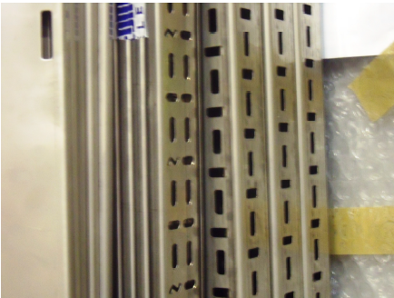
HS&E INCIDENT BULLETIN |  | 2nd Quarter 2012
Type of Incident: | Laceration
Summary:
Lacerations to palm of left hand requiring four stitches & cut to left wrist requiring two butterfly stitches. Cut left hand & right wrist whilst storing 100mm stainless steel electrical cable tray.
Root Causes: | Actions Taken Thus Far: Next Steps
• Poor quality components delivered from supplier. • Grey assembly gloves did not provide adequate protection against the razor sharp edge & a subsequent trial with our highest cut resistant gloves (category 5) on site failed to stop the burred edge slicing through the glove. | The storage area was cordoned off and the storage operation stopped pending an investigation to be conducted.

